Slide 1
The MODS Explorer App
UNITY, FUNCTION, ACCESIBILITY

Slide 2

What we’re about!
Our App (the Mods Explorer app), is meant to allow the user to see the museum and it’s exhibits in a whole new way. Allowing for digital interaction, learning, and fun. Our app seeks to enhance the museum experience.

Slide 3
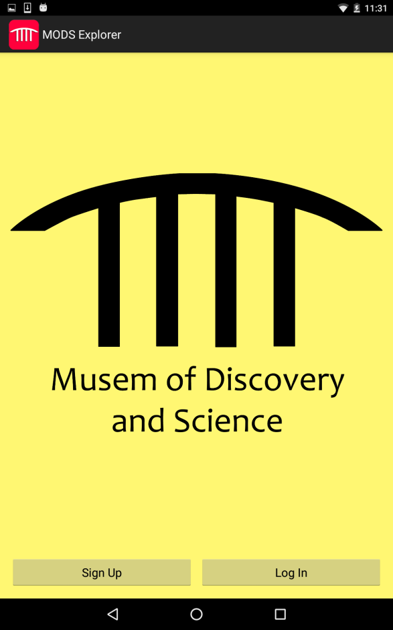
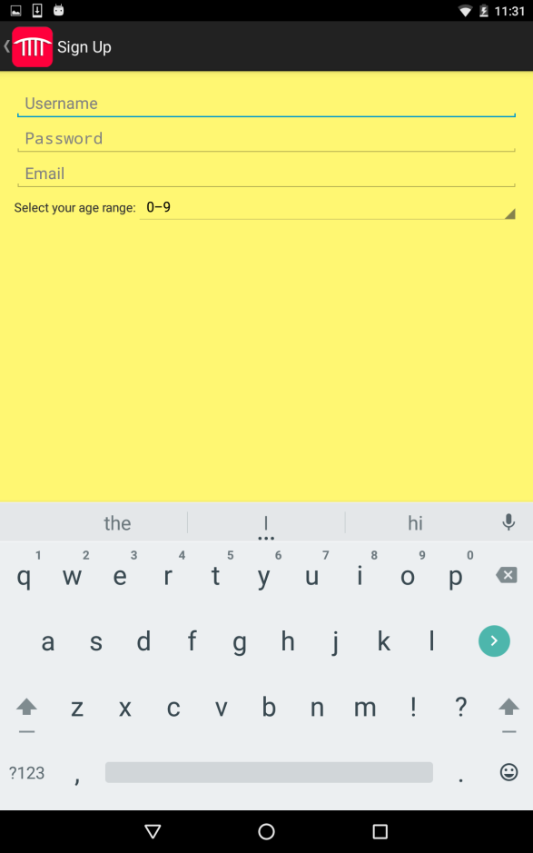
Sign-Up!
The sign up page welcomes the user. Allows for analytics and a member like experience.

Slide 4
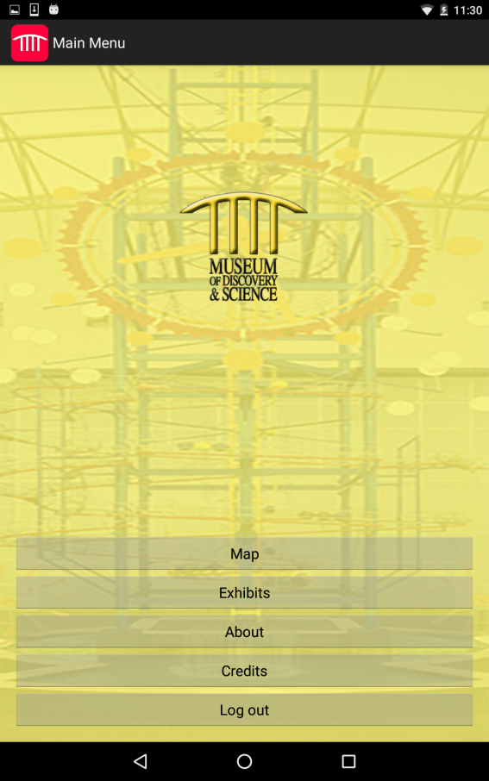
The Home Page
The purpose of this page is to guide the user to the other aspects of the app, the initial introduction to the app.

Slide 5
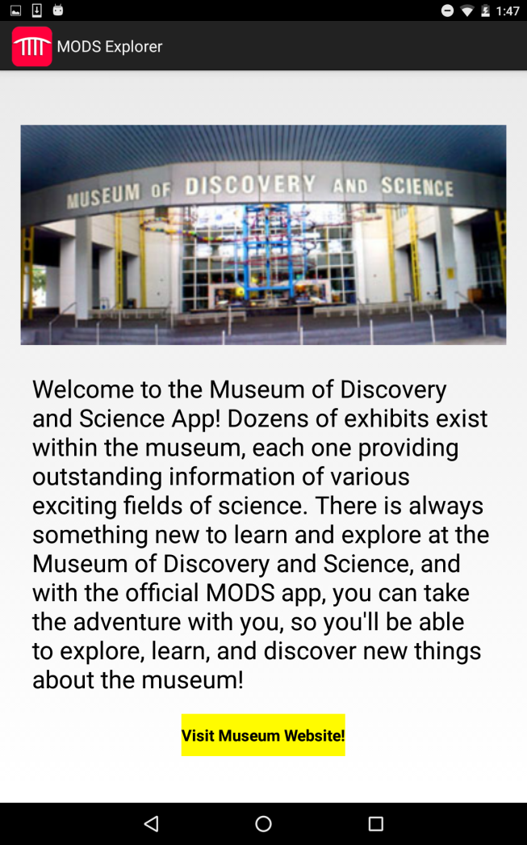
About
Gives an introductory paragraph about the app, explaining the interface to the user.

Slide 6
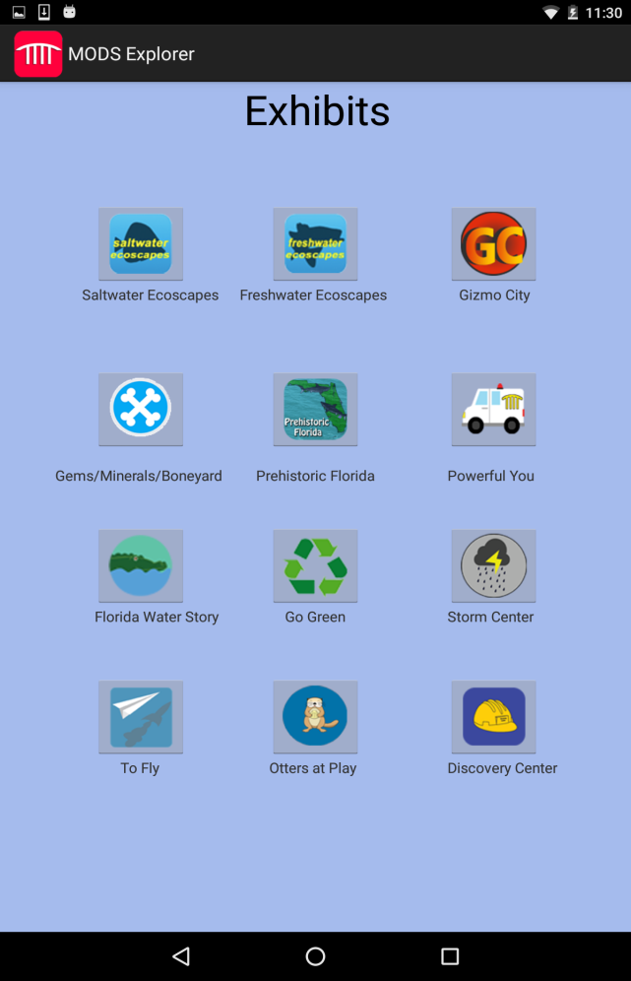
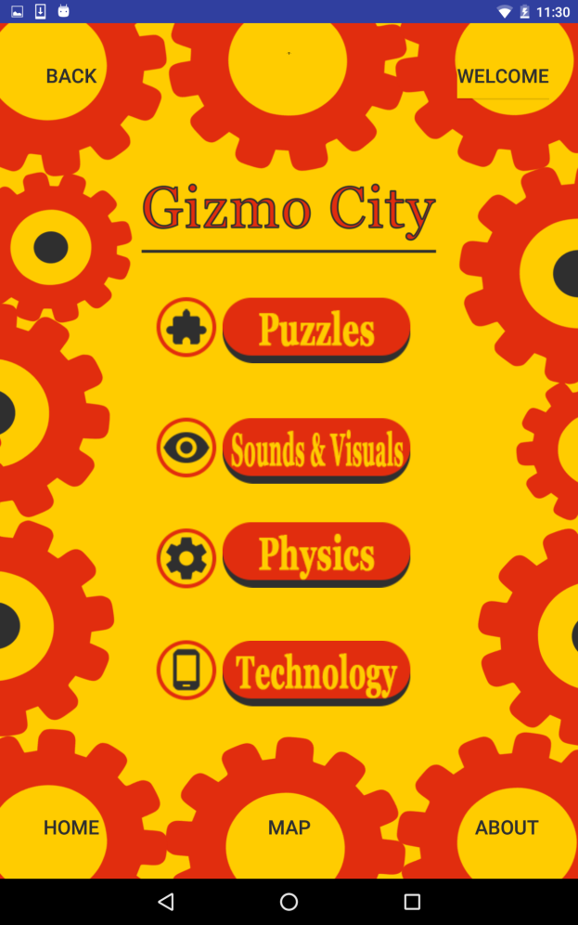
The Exhibits
Each group has created an app for each exhibit, The MODS Explorer app is just the glue that holds them all together. Providing a way to display all the MODS exhibits , allowing the user to interact with all of them at the touch of a button.

Slide 7
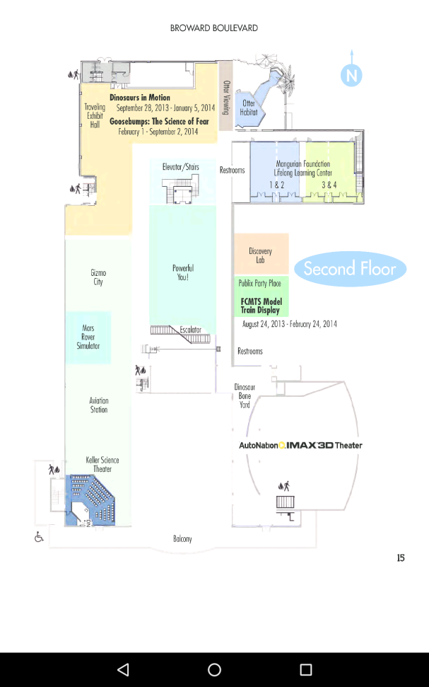
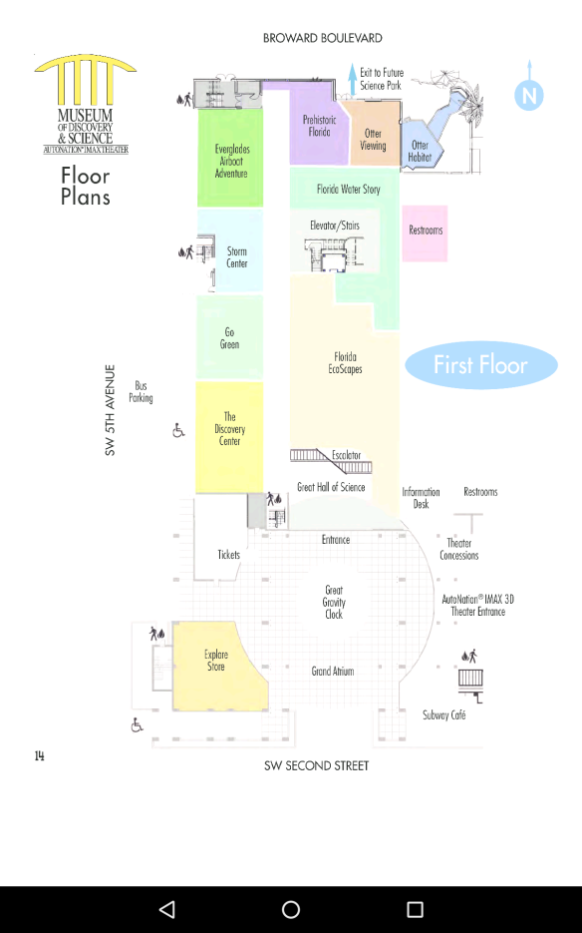
The Map
The Museum of Discovery and Science is still handing out paper pamphlets to this day. Not only is it an impact to our environment but it is also in impact on the museum financially. The MODS Explorer app seeks to replace these paper maps.

Slide 8





Questions?

